Slide 1

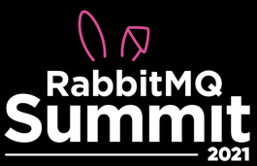

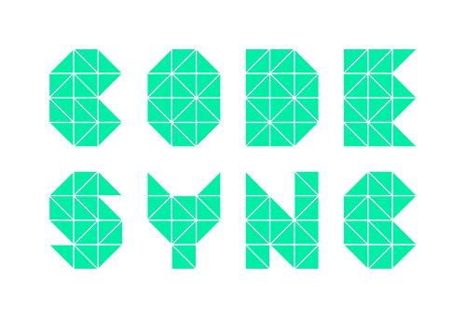

TUESDAY-
WEDNESDAY JULY 13-14
ORGANISERS
•virtual event•

Slide 2
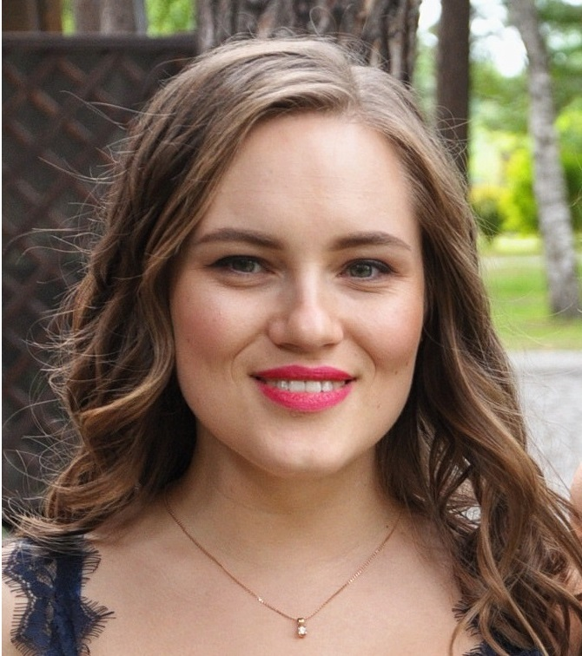


Maryna Zhygadlo Software Developer Diebold Nixdorf

Slide 3
Building distributed system for retail with RabbitMq

Slide 4
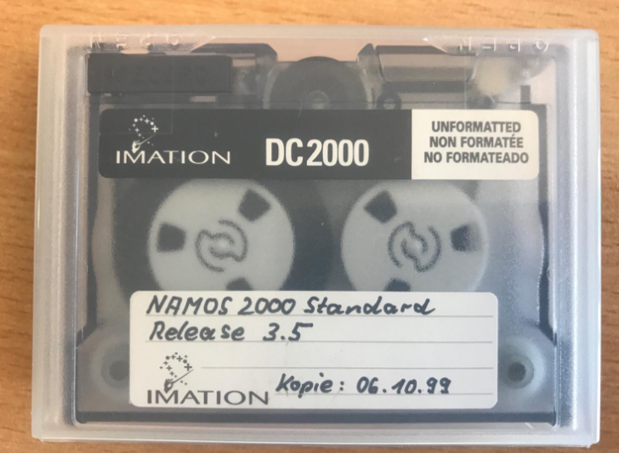

Cloud transformation

Slide 5

#1
Compatibility with the legacy monolithic app on-premises

Slide 6
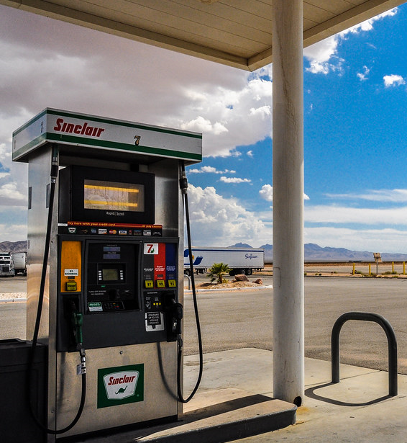
#2
Edges are in distant places with limited internet access

Slide 7
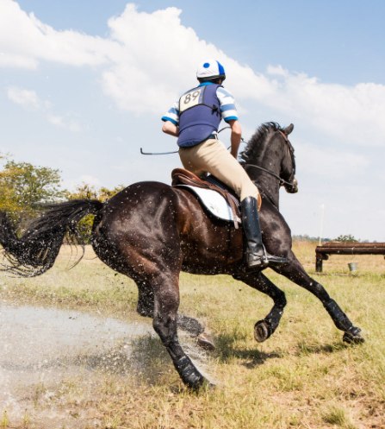
#3
Latency is crucial for the end-user

Slide 8

#4
Message payload should be minimized

Slide 9
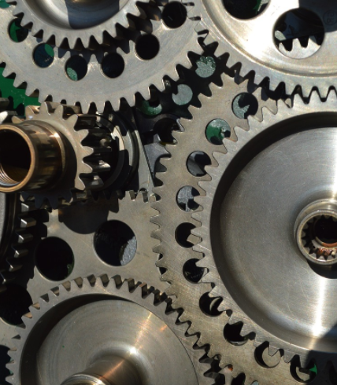
#5
Integration with third-parties to allow to interact with edges

Slide 10
What are the use cases?

Slide 11
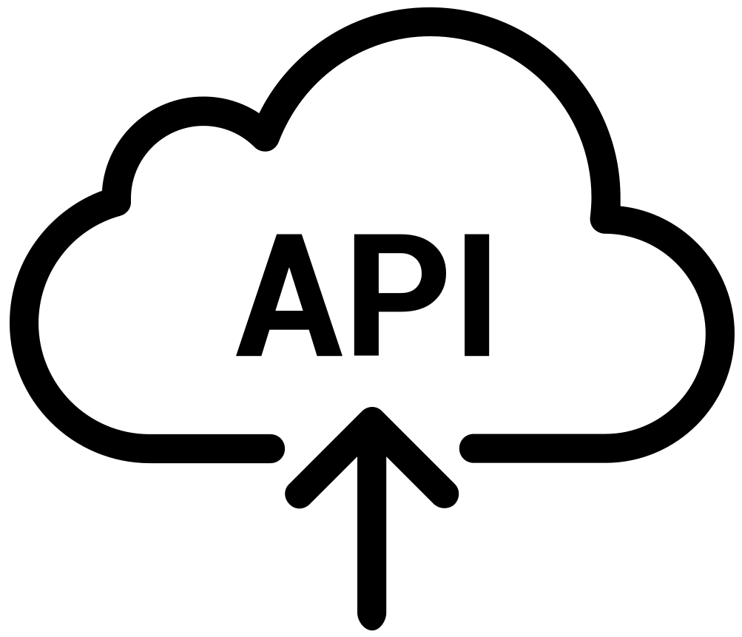
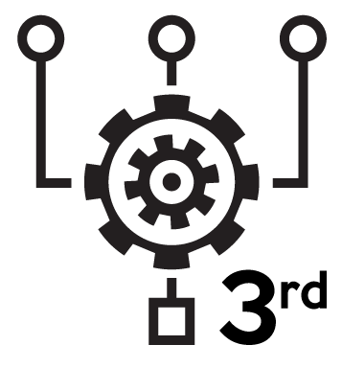


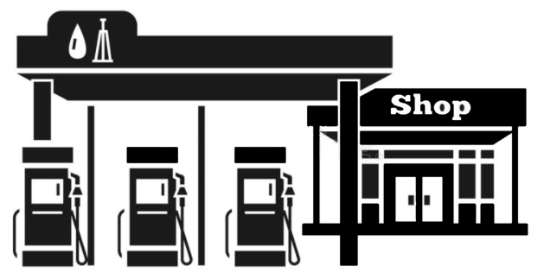
Accumulate data from edges
Edge 1
Edge 2
Edge 3
Edge N

Slide 12
Route data to edges
Edge 1
Edge 2
Edge 3
Edge N

Slide 13
What is under the hood?

Slide 14


Architecture overview
Items
Analytics
Import
Order
Discount
Payment
Sales
Audit

Slide 15
Fanout and federation
Ex
Ex
Queue
Consumer
fanout
Producer
Ex
Ex
Queue
Consumer
fanout
Ex
Ex
Queue
Consumer
fanout

Slide 16
Direct and shovel
Queue
Queue
Consumer
Producer
Ex
Queue
Queue
Consumer
routing key: edge name
direct
Queue
Queue
Consumer

Slide 17



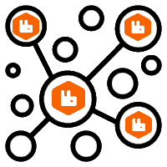

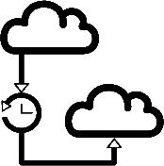


System in numbers
4.5K connections
≈700 edges
15 /s message rate
1.5K queues
536 ms latency
5 nodes cluster
4K exchanges
400-800B message payload

Slide 18
Demo solution in C#
https://github.com/marinazhyga/RabbitMqSummit2021
Solution in c# .NetCore 3.1 using MassTransit contains:
Slide 15: Producer publishes to a fanout exchange, dedicated to a certain edge.
Slide 16: Producer publishes to a direct exchange, where a routing key is a unique edge identifier.

Slide 19
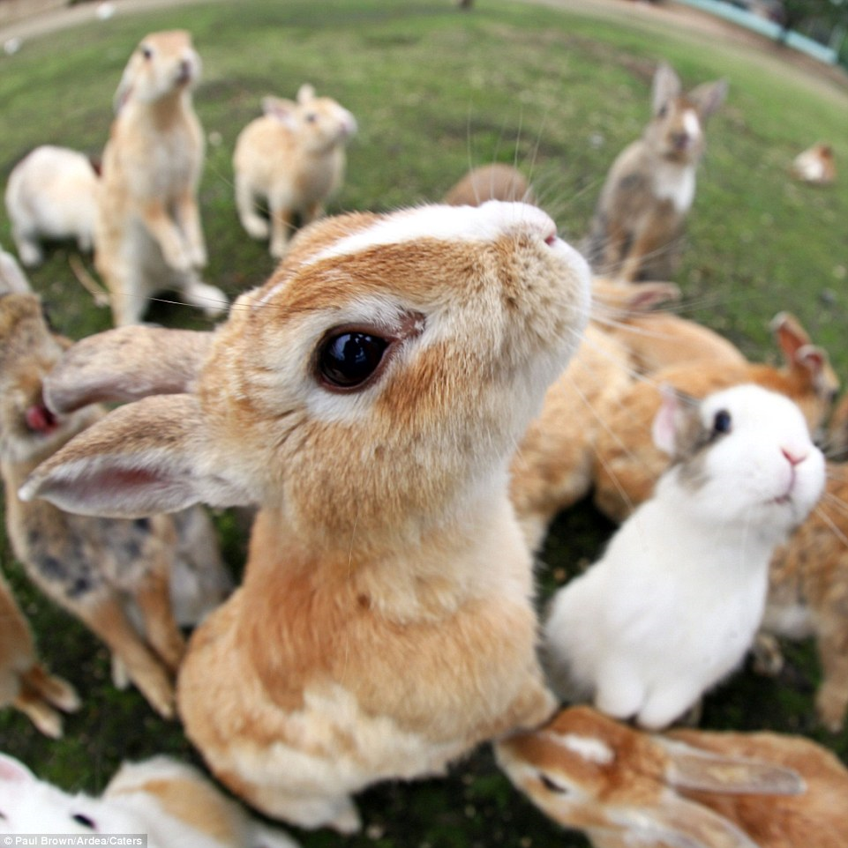
Thank you
for your attention!

